Slide 1
Running head: USE OF FACIAL RECOGNITION IN LAW ENFORCEMENT
Use of Facial Recognition in Law Enforcement
student’s Name
Institutional Affiliation
Date

Slide 2
Use of New Technologies in Law Enforcement
Technology is reshaping every sector of the economy worldwide.
Many countries are adopting sophisticated devices and application to help in all-round service delivery.
Police work in this 21st century has been transformed greatly.
New tools are being introduced that help in fighting crime as new categories of crime to fight are evolving.
Law enforcement leaders have coined high technology systems alongside complicated tools which are designed to;
Enhance public safety
Confiscate criminals, and
Save lives.

Slide 3
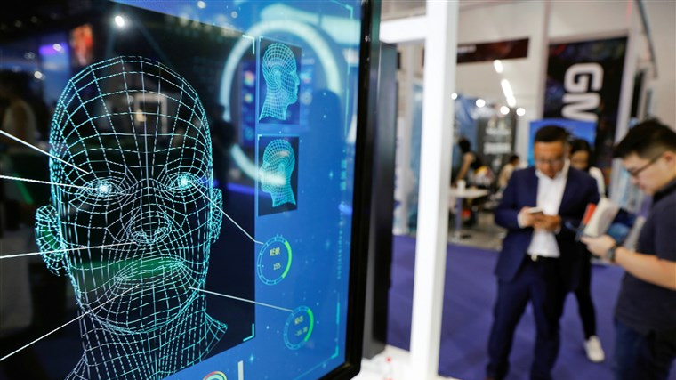
Facial Recognition Software
Facial recognition is one of the controversial emerging technology in the law enforcement department.
Most cities are fitted with video surveillance cameras that are powered by artificial intelligence.
The technology is offering dazzling potential in crime prevention.
In general, facial recognition is the aspect of using fed information in cameras from footages and going through databases to identify similar faces of the perpetrators.
Notes:
The technology is seemingly transforming the law enforcement department as criminals are arraigned just from their identity by cameras.
Facial recognition has given police a powerful new tool for tracking down perpetrators.
However, the technology is as well raising questions over its authenticity on specificity of criminal’s face identification. The technology uses algorithms to match a person's facial characteristics across photos and videos obtained from crime scenes. The facial recognition technology has already ben applied in several other places like in Facebook tagging, unlocking of phones. From what the technology has seemingly achieved, it is believed that there will much advantage for its use in law enforcement than the little flaws it might be associated with.

Slide 4
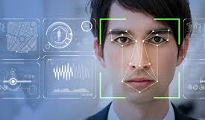
Investigative use of Facial Recognition
Facial recognition technology is used by law enforcement in the general surveillance.
For instance, in 2001, it was used in the Super Bowl in Florida in screening for potential criminals from the event.
However, the results from this case were mixed as 19 people were identified only to be regarded as minor criminals resulting in some false positive identification.
There have been developments rom then with the recent being its use in Baltimore police in the monitoring of protesters in an unrest and rioting after death of Freddie Gray.
Protesters were arrested later and apprehended.
Notes:
The instances of facial recognition application in law enforcement seemed to be flawed and raised questions over the use of the technology. However, much development has been done in terms of specific identification of perpetrators from the camera footages. In the recent cases, facial recognition has been used in identifying criminals in mass shootings in the United States and other crime perpetrators and this has helped greatly reduce crime rates in major cities.

Slide 5
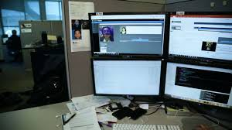
Targeted Photo Comparison
Despite general surveillance posing some problems in the use of facial recognition, the facial recognition technology has been used in effective identity of thousands of criminal suspects that are related to fraud with cases of driver license frauds.
Airports use facial recognition technology to aid passengers boarding planes based on the photographic images taken and not boarding passes.
Notes:
Facial recognition has been greatly used in New York city in fraud identification. According to the New York police department, more than 10,000 people have been identified with possession of more than one driving license. Similarly, in New Jersey, the Department of Motor Vehicle have identified about 2,500 cases of fraud regarding false photo identification and people posing to be identified as different people. The use of Facial recognition has facilitated the identification of impersonation and use of other people driving license with other similar and related people.

Slide 6
Impact of Facial Recognition Technology on Law Enforcement
Facial recognition has seen greater improvement and incorporation in law enforcement despite the challenges it has been going through.
For instance, San Francisco has banned the use of facial recognition in criminal identification, emphasizing on the tension created by the technology.
However, there is need for the government to adopt a system for criminal identification and investigation that are much better and innovative and thus allow them serve the public.
Facial recognition has the potential of helping law enforcement in confiscating criminals.
The technology is further promising public safety .

Slide 7
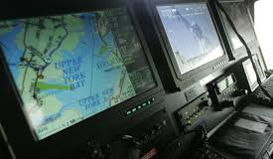
Current use of Facial Recognition in Law Enforcement
Law enforcement agencies are appreciating the development of technology and further looking for ways of increasing their service through technology.
Facial recognition is promising effective criminal detection from the recent developments.
As technology shifts, it is believed that more inventions are being made to facilitate and increase effective use of facial recognition in more law enforcement sectors.
Notes:
The banning of the use official recognition technology use in some cities is an outright unwarranted action that has no any provision. The policies on the use of facial recognition technology need to be revisited as the ban is locking out the use of helpful tools that assist law enforcement in serious crimes where the traditional techniques of criminal investigations can fail. For instance, in the United States, there has been a recent increase in mass shootings where the criminal vanish into thins air. The use of facial recognition technology from any footage of the criminal can assist to apprehend the criminal in the shortest time possible before such people move to different cities or countries. The technology can be employed in airports to facilitate scanning of the faces of travelers so that the pepetrators can easily be identified.

Slide 8
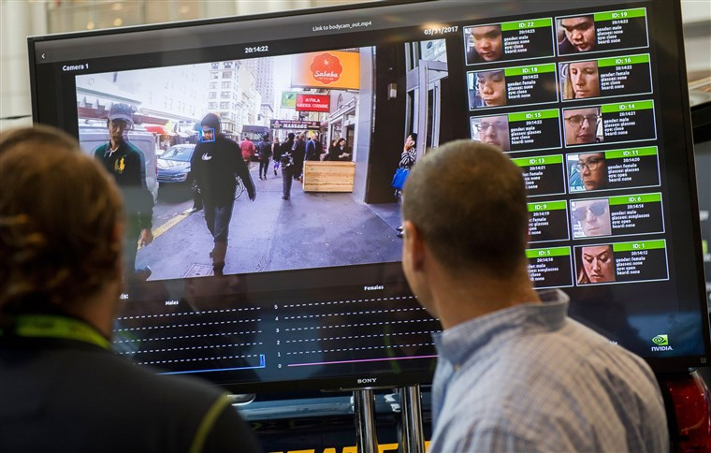
Expectations From the Use of Facial Recognition
There is nothing anticipated like reducing the time and resource for criminal identification.
The use of increased technology in criminal law enforcement is geared towards justifying cases in the shortest tie possible.
Facial recognition technology in law enforcement in unforeseeable to revolutionize the way criminal justice systems and as well facilitate the upending of criminals.
Recent advances indicate a more specific and accountable criminal detention systems through facial recognition.

Slide 9
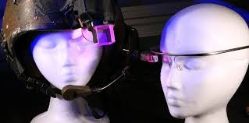
Misconceptions on Facial Recognition Technology
The proponent use of Facial Recognition technology by police argue that,
Privacy of a person's face cannot be expected once it has been taken out to the public.
That any intrusion of privacy is a small price to pay for the increased safety of the public.
However, this is a misconception since the government has already a digital algorithm of a person face in form of ID and thus there is nothing wrong.
Notes:
Facial recognition technology allows for different kind of tracking, and this can occur from far way in a secret way and on large number of people. facial recognition incorporates the use of fingerprints that are left in the things that people touch and when police take them, they analyze and find the person. faces are not left at home and hence from security cameras, the person’s current location can be located.

Slide 10
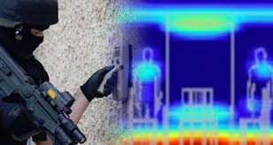
Citizen’s perception of the use of Facial Recognition
Every citizen has come into terms with the increasing technologies in the world.
The use of Facial recognition is a bold step that has been accepted by many despite the opposition of public safety.
It is, however, understandable that all is meant for the safety of the public and thus, there should be no objection towards the use of the technology.
In early times, before the efficacy of the technology and mis-identity, the perception of the use of Facial recognition was low and citizens never believed in its effectiveness.
Notes:
Facial recognition has greatly been accepted by the public since it has proved its effectiveness in law enforcement. Many instances of crimes in the United States that could have otherwise been challenging by use of the traditional forms of investigation have been fully analyzed through use of facial recognition. Many criminals have been apprehended through the use of the technology and thus, from this effectiveness of the technology, many people have accepted its use and no longer oppose.

Slide 11
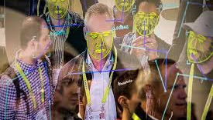

Merits of Facial Recognition in Law Enforcement
Faster crime detection
Specificity in detection of crime perpetrators
Increased safety and security
Quick, automatic and seamless facial experience.
Convenient
Notes:
Facial recognition has gained massive usage in the past decade. According to the Homeland security, by 2023, 97 % of air travelers will have used facial recognition instead of the other means of recognition. Besides, facial recognition has promise and in crease in safety and security of the public. For instance, police have been able to apprehend criminals of cases of rape in New York using facial recognition. This is among the many cases that facial recognition has facilitated. Facial recognition adds to conveniences as well. It helps in Facebook and other social media tagging.

Slide 12
References
Bambha, M., Anderson, T., Pearman, S., & Roussilhon, V. (2011). U.S. Patent Application No. 12/752,106.
Bonsor, K., & Johnson, R. (2001). How facial recognition systems work. HowStuffWorks. Com Np, 4.
Buckley, B., & Hunter, M. (2011). Say cheese! Privacy and facial recognition. Computer Law & Security Review, 27(6), 637-640.
Cohen, M. E., & Carr, W. J. (1975). Facial recognition and the von Restorff effect. Bulletin of the Psychonomic Society, 6(4), 383-384.
Introna, L., & Wood, D. (2004). Picturing algorithmic surveillance: The politics of facial recognition systems. Surveillance & Society, 2(2/3), 177-198.
Jain, A. K., Klare, B., & Park, U. (2011, March). Face recognition: Some challenges in forensics. In Face and Gesture 2011 (pp. 726-733). IEEE.
Milligan, C. S. (1999). Facial recognition technology, video surveillance, and privacy. S. Cal. Interdisc. LJ, 9, 295.
Sajjad, M., Nasir, M., Muhammad, K., Khan, S., Jan, Z., Sangaiah, A. K., ... & Baik, S. W. (2017). Raspberry Pi assisted face recognition framework for enhanced law-enforcement services in smart cities. Future Generation Computer Systems.

